Slide 1
Providing Primary Healthcare to the
Mid-Shore Region Since 1980
A Federally Qualified Health Center and
New HEZ Partner in 2015

Slide 2
Our Mission
Choptank Community Health provides Quality Health Care for All

Slide 3
Our Vision
CCHS will be the health care provider of choice for area residents.
Services will be provided by working both individually and in partnership with other health care and community organizations.
CCHS will be representative of the communities served, professional and culturally competent.
We will be committed to excellence.

Slide 4
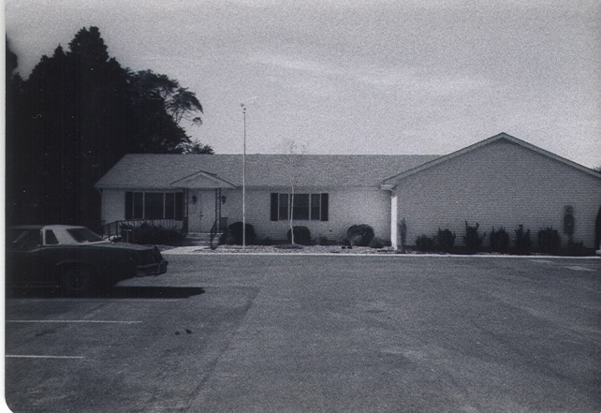
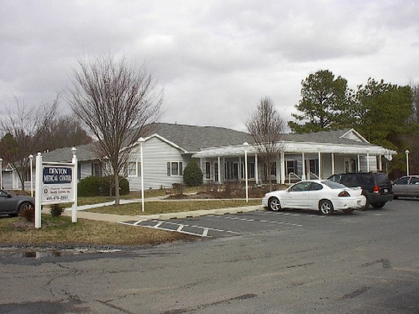
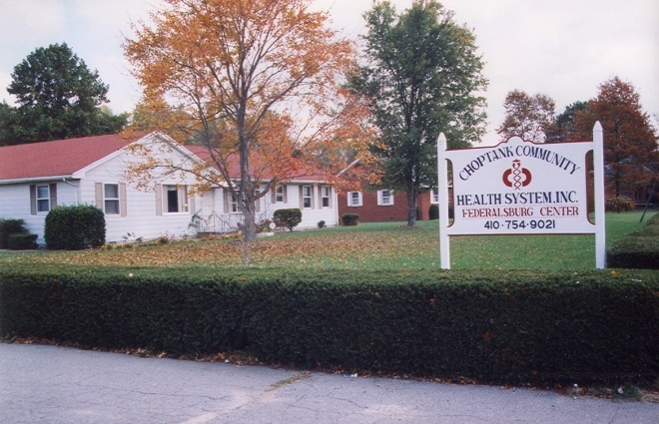
Our History
Starting out as Caroline Health Services, Inc., CCHS was incorporated as a private not for profit organization in 1978 to establish comprehensive primary health care services for the residents of Caroline County.
In 1980, funds from the Public Health Service (PHS) established the Goldsboro Medical Center in the northern part of Caroline County.
Two additional sites were opened in the county within the decade, the Denton Medical Center in 1982 and the Federalsburg Medical Center in 1990.

Slide 5
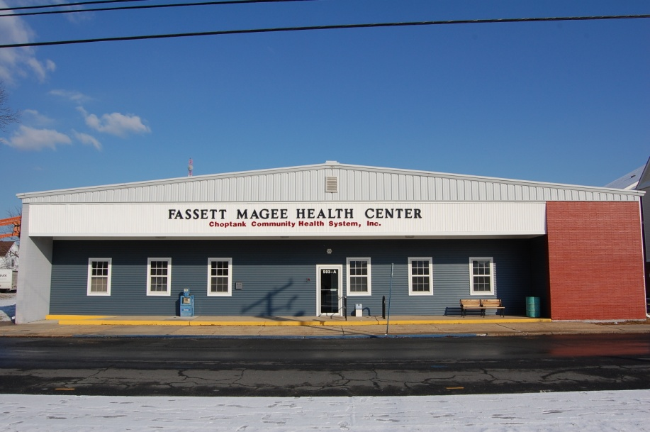
Our History
In 1998, Caroline Health Services extended services to Dorchester County through the acquisition of the Fassett-Magee Community Health Center in Cambridge.
With this merger, the organization name changed to Choptank Community Health System, Inc.
In 2009 we added the Bay Hundred Health Center in St. Michaels

Slide 6
CCHS Today
5 primary care centers in the 3 Counties of the Mid-Shore. Centers are located in Goldsboro, Denton, Federalsburg, Cambridge and St. Michaels. Women’s Health services available at the FMMC and the DMC.
Co-located Behavioral Health services provided at our Bay Hundred Center in St Michaels and at our school based programs in Caroline County.
9 School based health centers in Caroline County offer primary
health care services. Behavioral health services are offered in partnership with the Caroline County Health Department. 4 School based health centers in Talbot County. Preventive oral health services through a School Based Dental Program in Caroline, Dorchester and Talbot Counties.
Dental services in Federalsburg, Goldsboro, and Cambridge. In addition to regular dental services we can provide hospital based services at Dorchester General Hospital.
Medical Services to Migrant farm and seasonal workers in 5 Counties.
Population Health Focus

Slide 7
In 2014 we served 25,000 patients on the Eastern Shore

Slide 8
Federalsburg Medical & Dental Center
Medical Provider Staff
  2 Family Nurse Practitioners
  1 Family Practice MD
Dental Provider Staff
  1 Dentist
  1 Hygienist

Slide 9

Fassett Magee Health Center and Cambridge Dental Center
Medical Provider Staff
  2 Family Nurse Practitioners
  1 Physician’s Assistant
  1 Women’s Health Nurse Practitioner
  1 Part time Pediatrician (beginning October 2015)
  Supervising Medical Director
Dental Provider Staff
  2 Dentists
  2 Hygienists

Slide 10
Patient Population
Jan 2014-Aug 2015
Cambridge
Federalsburg
Medical 3,932
Dental 2,561
3,988 Female
2,505 Male
Age Groups
  0-18 2,293
  19-16 3808
  >65 392
Medical 2,889
Dental 1,559
2,528 Female
1,920 Male
Age Groups
  0-18 951
  19-64 2,983
  >65 514

Slide 11
Chronic Disease

Slide 12
Chronic Disease

Slide 13
Population Health
Quality Management Department
  Panel Manager
  Clinical Informatics Coordinator
  Dental Case Manager
  Patient Services Coordinators
  Nurse Care Coordinators

Slide 14
Population Health
Value Based Purchasing for MCO’s
  Well Child Checks
  Lead Screening
  Immunizations – Combo 3 and Adolescent
  BMI
  Breast Cancer Screening
  HbA1c
  Post Partum Visit
  SSI Adult and Child

Slide 15
Population Health
Care Coordination
  Hospital Follow-Up
    CRISP data reviewed daily
    Goal – all discharged patients are seen by their PCP within 7 days of discharge
    Phone call from care coordinator shortly after discharge to do medication reconciliation and ensure patient understands follow up plan.
    Coordinating care with Shore Regional Health discharge planners

Slide 16
Population Health
Care Coordination
  Emergency Department Follow Up
    CRISP data reviewed daily
    Coordination with Triage nurse at sites to ensure necessary follow up
      Phone calls to patients to ensure they are aware of availability at the health center for non-emergency care
      Follow up appointments with PCP if necessary
    Patients seen in ED for dental complaints are forwarded to the Dental Case Manager
    Working with Care Coordination at Shore Regional

Slide 17
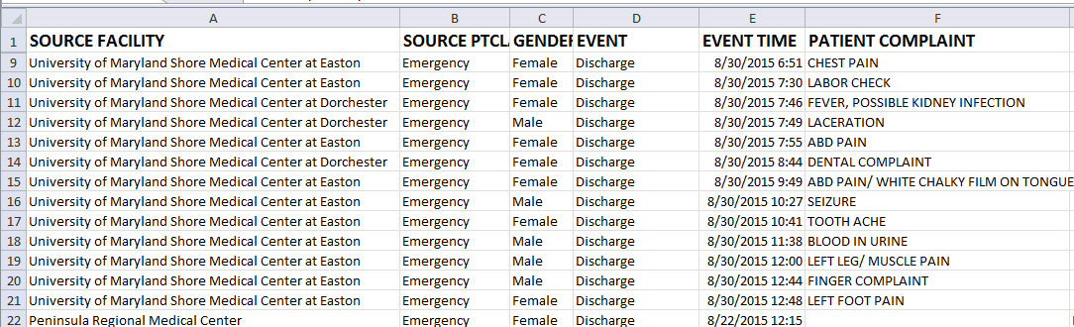
CRISP

Slide 18
Partners
Shore Regional Health
  Transitions in Care
Mid-Shore Coalition
  Check Change Control
County Health Departments
  Chronic Disease Management and Diabetes Prevention
  HEZ
Priority Partners MCO

