Slide 1
Data Tools to Track Population Health in the HEZs
Maryland Department of Health and Mental Hygiene
Virtual Data Unit

Slide 2
Prevention Quality Indicators (PQI)

Slide 3
Prevention Quality Indicators (PQI)
PQIs. PQIs are measures used with inpatient discharge data to identify quality of care for ambulatory care sensitive conditions.
Good quality outpatient care can potentially prevent the need for hospitalization
Early intervention can prevent complications or more severe disease.
“Preventative Hospitalizations.”
Population based and adjusted for covariates.

Slide 4
PQIs: Preventable Hospitalizations
Overall Composite.
Acute Composite.
Chronic Composite.
OVERALL = ACUTE + CHRONIC
Separate composite measures were created for acute and chronic conditions to investigate different factors influencing hospitalization rates for each condition.

Slide 5
PQIs: Preventable Hospitalizations
OVERALL
CHRONIC:
Diabetes with short-term complications
Diabetes with long-term complications
Uncontrolled diabetes without complications
Lower extremity amputations among admissions for diabetes
Asthma
COPD
Hypertension
Angina without procedure
Congestive heart failure (CHF)
ACUTE:
Bacterial pneumonia
Dehydration
Urinary tract infection

Slide 6
PQIs: Preventable Hospitalizations DATA SOURCE & LIMITATIONS
HSCRC data. Hospitalizations at Maryland’s 46 acute care and 5 specialty hospitals.
Maryland residents.
Limitations.
Hospitalizations, in general, on downward trend.
Does not capture Maryland residents visiting hospitals outside of Maryland.
Generally affects PG and Montgomery County rates.

Slide 7
PQIs: Preventable Hospitalizations INTERPRETATION
Compare the HEZ rates to Maryland rates
Is the HEZ above or below the State?
Compare HEZ rate trends over time
How is the HEZ changing over the years?
Is the trend different than Maryland?

Slide 8
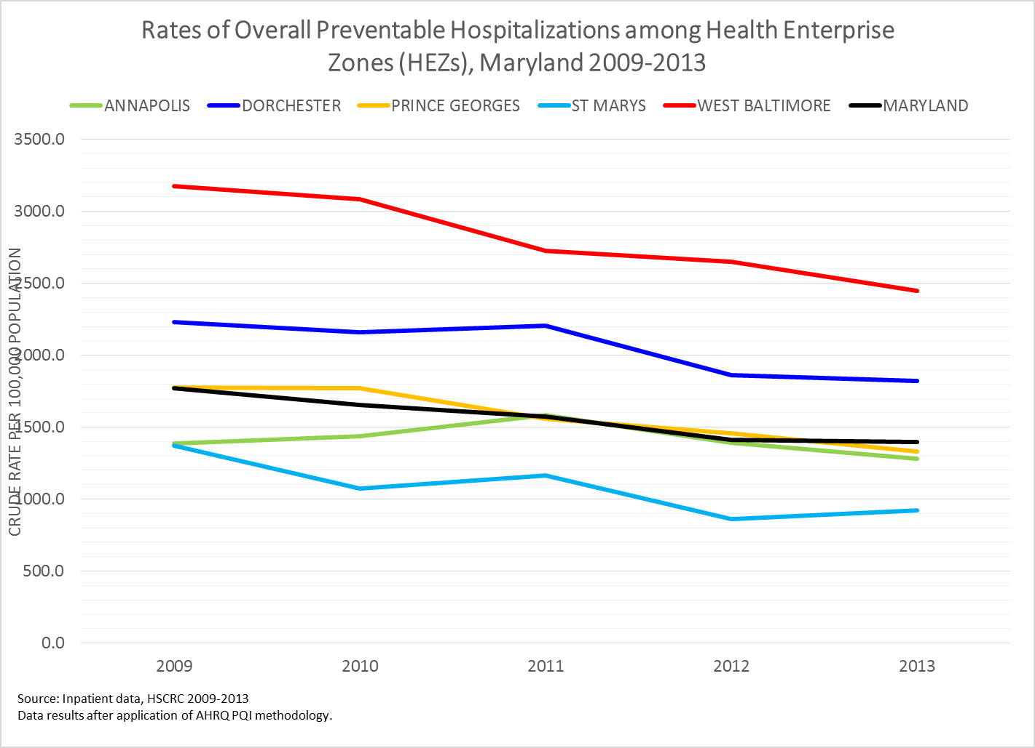

Slide 9
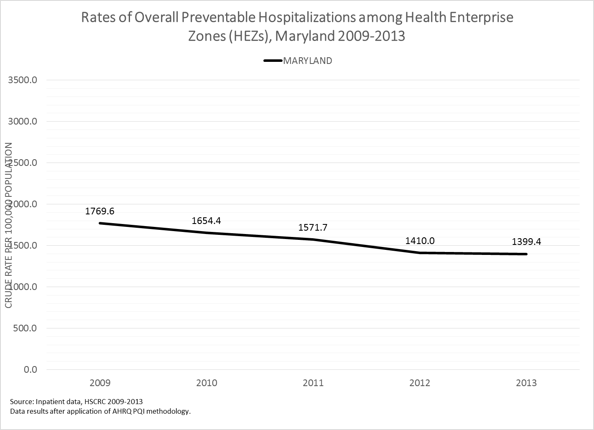

Slide 11
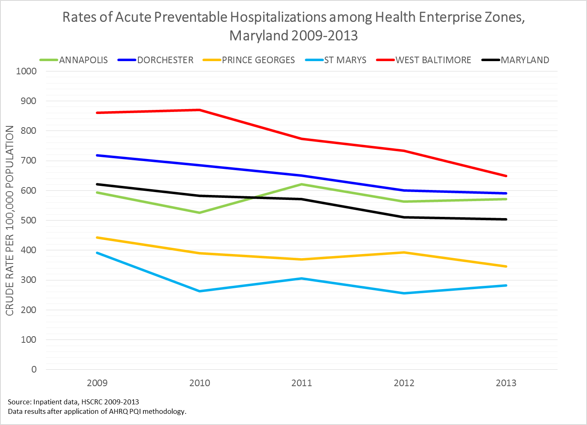

Slide 12
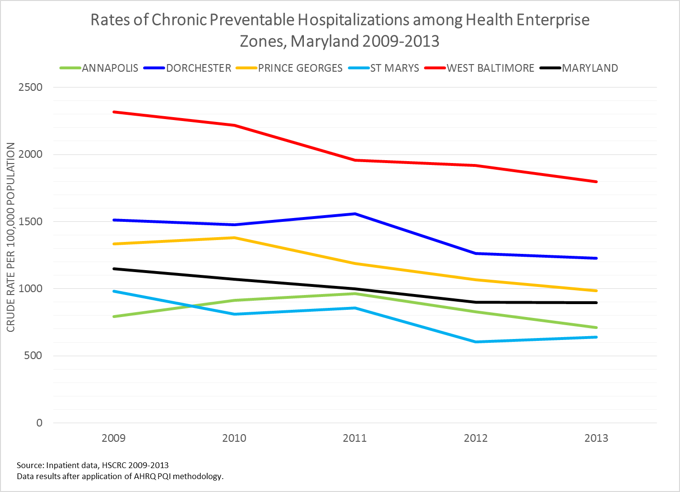

Slide 13
PQI Rates
ALL PQIs
 | 2009 | 2010 | 2011 | 2012 | 2013
ANNAPOLIS | 1387.0 | 1437.8 | 1585.5 | 1391.1 | 1282.1
DORCHESTER | 2231.5 | 2160.9 | 2207.0 | 1863.1 | 1819.5
PRINCE GEORGES | 1777.5 | 1771.6 | 1557.2 | 1460.2 | 1330.2
ST MARYS | 1370.7 | 1073.4 | 1163.8 | 860.9 | 921.9
WEST BALTIMORE | 3177.5 | 3086.9 | 2728.5 | 2652.7 | 2445.9
MARYLAND | 1769.6 | 1654.4 | 1571.7 | 1410.0 | 1399.4
ACUTE PQIs
 | 2009 | 2010 | 2011 | 2012 | 2013
ANNAPOLIS | 593.6 | 525.3 | 620.6 | 562.4 | 571.3
DORCHESTER | 718.2 | 685.1 | 649.6 | 600.7 | 590.7
PRINCE GEORGES | 442.5 | 390.2 | 368.9 | 393.5 | 346.0
ST MARYS | 391.2 | 262.9 | 305.5 | 255.6 | 282.1
WEST BALTIMORE | 860.7 | 869.6 | 773.0 | 733.5 | 648.2
MARYLAND | 621.7 | 583.1 | 571.0 | 510.8 | 503.2
CHRONIC PQIs
 | 2009 | 2010 | 2011 | 2012 | 2013
ANNAPOLIS | 793.4 | 912.4 | 964.8 | 828.7 | 710.8
DORCHESTER | 1513.3 | 1475.8 | 1557.4 | 1262.4 | 1228.8
PRINCE GEORGES | 1335.0 | 1381.5 | 1188.2 | 1066.6 | 984.2
ST MARYS | 979.5 | 810.5 | 858.4 | 605.3 | 639.8
WEST BALTIMORE | 2316.8 | 2217.3 | 1955.5 | 1919.1 | 1797.7
MARYLAND | 1148.0 | 1071.3 | 1000.7 | 899.3 | 896.4

Slide 14
PQIs: Preventable Hospitalizations RESULTS
HEZs Higher than Maryland:
Annapolis: Acute PQI (^2013)
Dorchester: Acute, Chronic = Overall
Prince Georges: Chronic PQI
St. Mary’s: None (^2013 Acute, Chronic = overall)
West Baltimore: Acute, Chronic = Overall

Slide 15
HEZ Data Portal: Hospitalizations & Readmissions

Slide 16
HEZ Data Portal
Designed by CRISP.
HSCRC data on HEZ residents.
DHMH supplied methods.
HSCRC’s readmission definition (CMS modified).
Numerator: # of unplanned 30 day, all cause, all hospital readmissions
Denominator: # of expected readmissions

Slide 17
HEZ Data Portal
Excludes:
Missing EID, duplicates, negative day stays.
Readmissions occurring same day (treated as transfers).
Death occurring on index admission.

Slide 18
HEZ Data Portal
HEZ Data Portal.
(INSERT WEBSITE LINK)

Slide 19
THANK YOU
Andrea Bankoski, MPH
Virtual Data Unit Manager
Maryland Department of Health and Mental Hygiene
andrea.bankoski@maryland.gov

